Slide 1
Machine learning for biology workshop
Fangzhou Mu

Slide 2
After the workshop, you will…
Know what machine learning (ML) does and why it can be useful in biological research.
Be able to read papers that apply (simple) ML to biological problems.
Understand (some of) the language used by computational biologists and be more comfortable to collaborate with them.
Be prepared to explore opportunities of applying ML in your own projects.

Slide 3
We will cover…
An introduction to ML
Motivation
Tasks (we will focus on classification)
The basics of ML
ML vocabulary
Typical ML workflow
Some simple (but popular) classification models
Neural Networks, Random Forests, Support Vector Machines, Naïve Bayes …
Evaluation of classifier performance
Metrics
Plots
Hands-on practice with toy and real datasets

Slide 4
We will NOT cover…
Coding
We will click on buttons in a user-friendly software.
Math
Math only appears when it is absolutely needed.
However, it can still be intimidating when it shows up.
We will focus on intuition, not calculation.
Feature engineering
We primarily study the “core” of ML.
However, engineering tricks are critical to the success of ML in practice.
Highly domain specific, a lot of folk wisdom, no universal guideline, coding required.
The state-of-the-art models at the frontier of ML/bioinformatics research
Too much math and coding involved, not appropriate for beginners

Slide 5

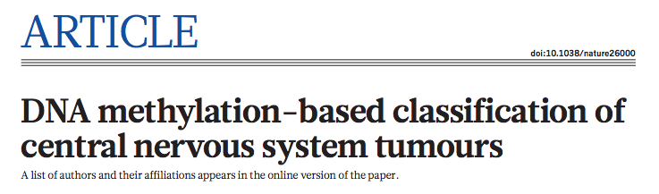
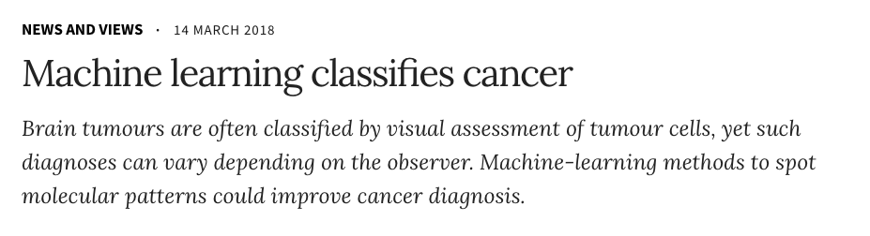
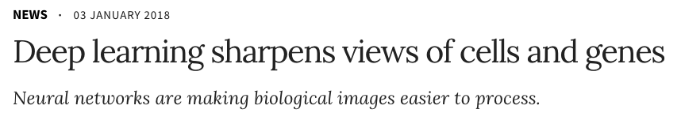
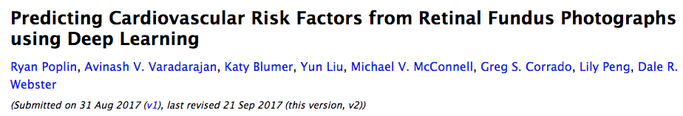
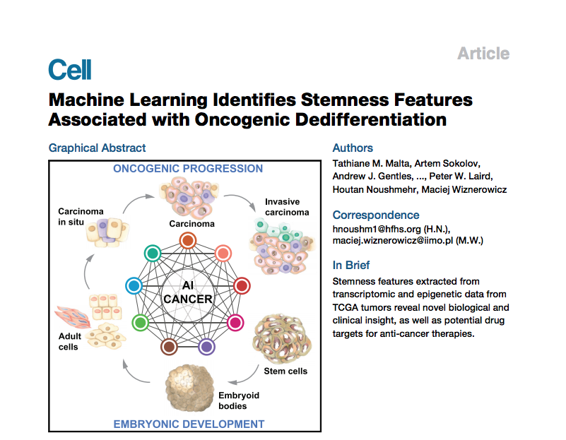
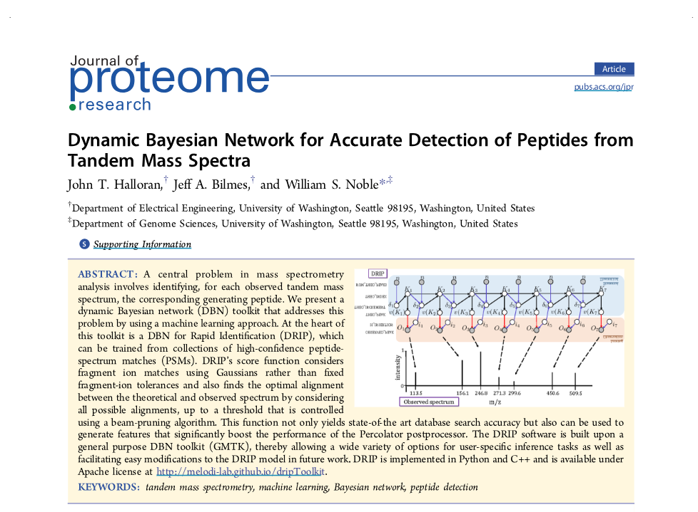
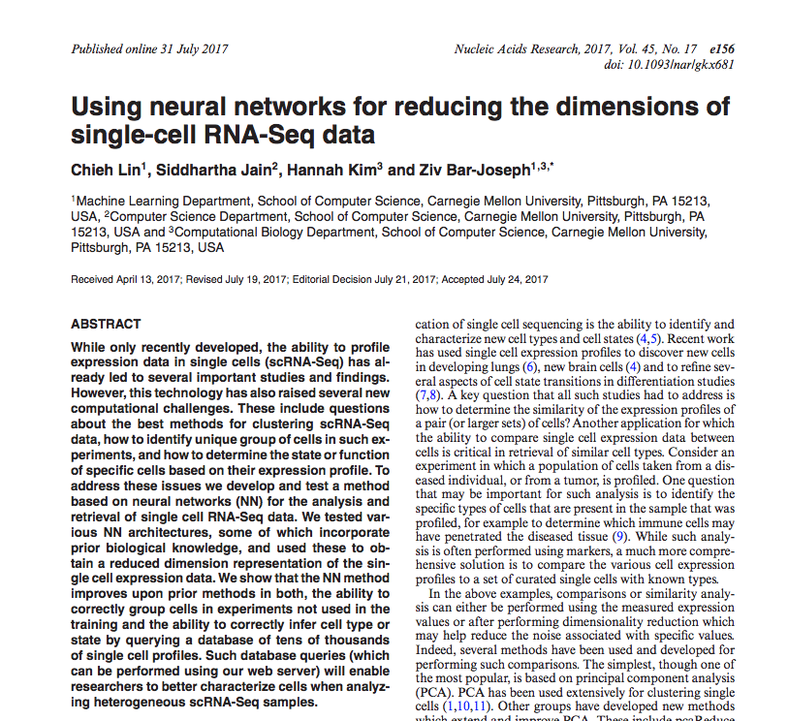
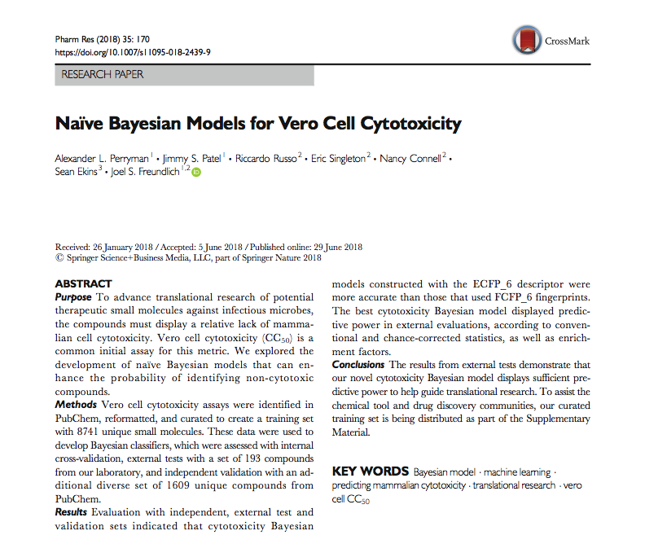
ML in biology
Nature. 2018 Mar 22;555(7697):469-474.
https://www.nature.com/articles/d41586-018-02881-7
https://www.nature.com/articles/d41586-018-00004-w
arXiv:1708.09843v2 [cs.CV]
Cell. 2018 Apr 5;173(2):338-354.e15.
Nucleic Acids Res. 2017 Sep 29;45(17):e156.
J Proteome Res. 2016 Aug 5;15(8):2749-59.
Pharm Res. 2018 Jun 29;35(9):170.

Slide 6
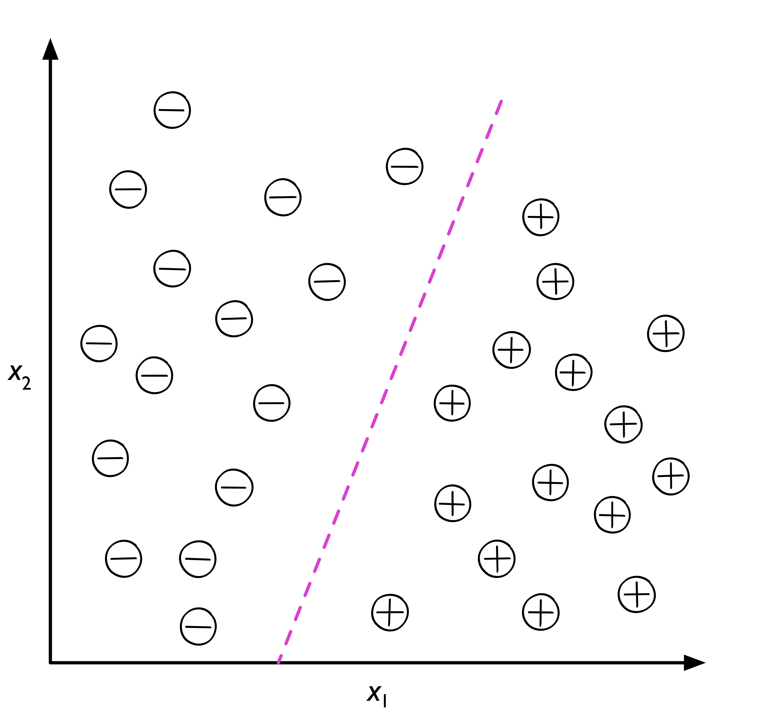
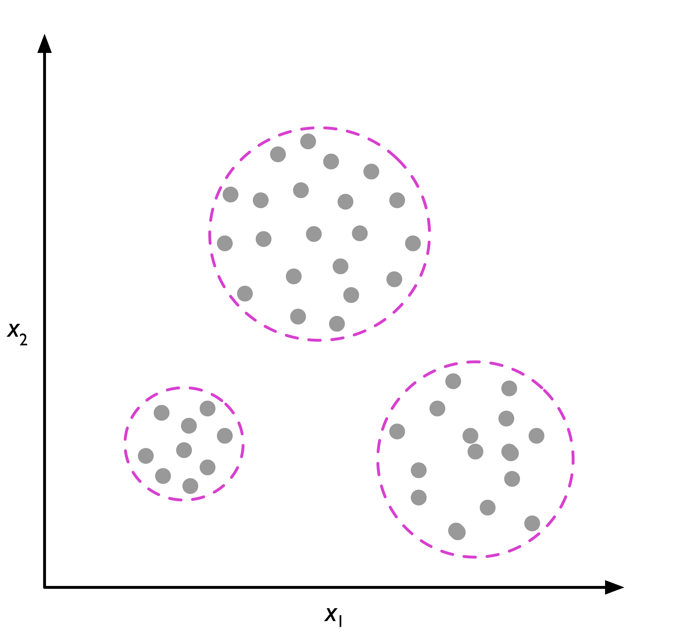
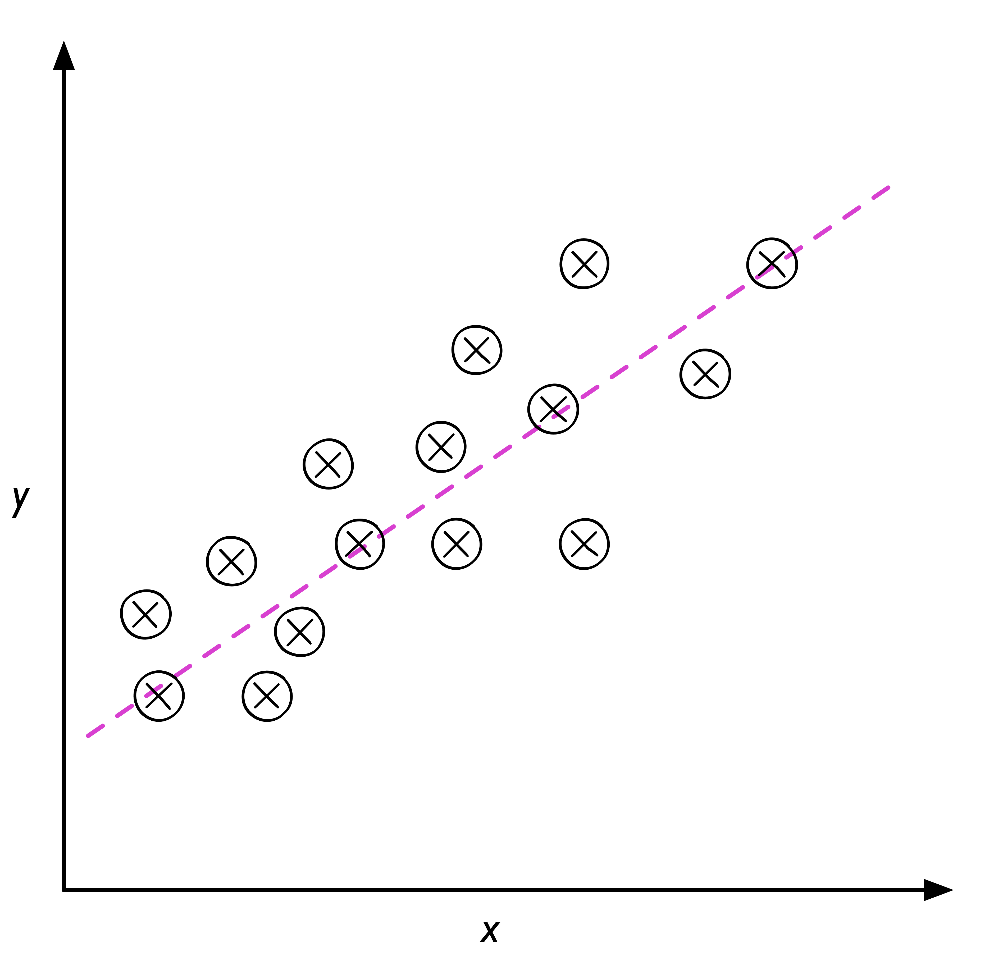
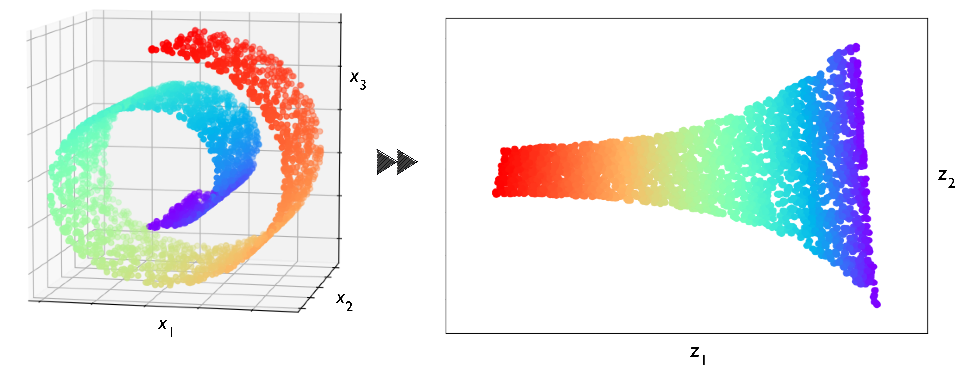
ML tasks
Supervised learning
Unsupervised learning
Classification
Clustering
Regression
Dimensionality reduction
Images from
https://github.com/rasbt/python-machine-learning-book-2nd-edition
S. Raschka and V. Mirjalili, Python Machine Learning (2nd Ed.)

Slide 7
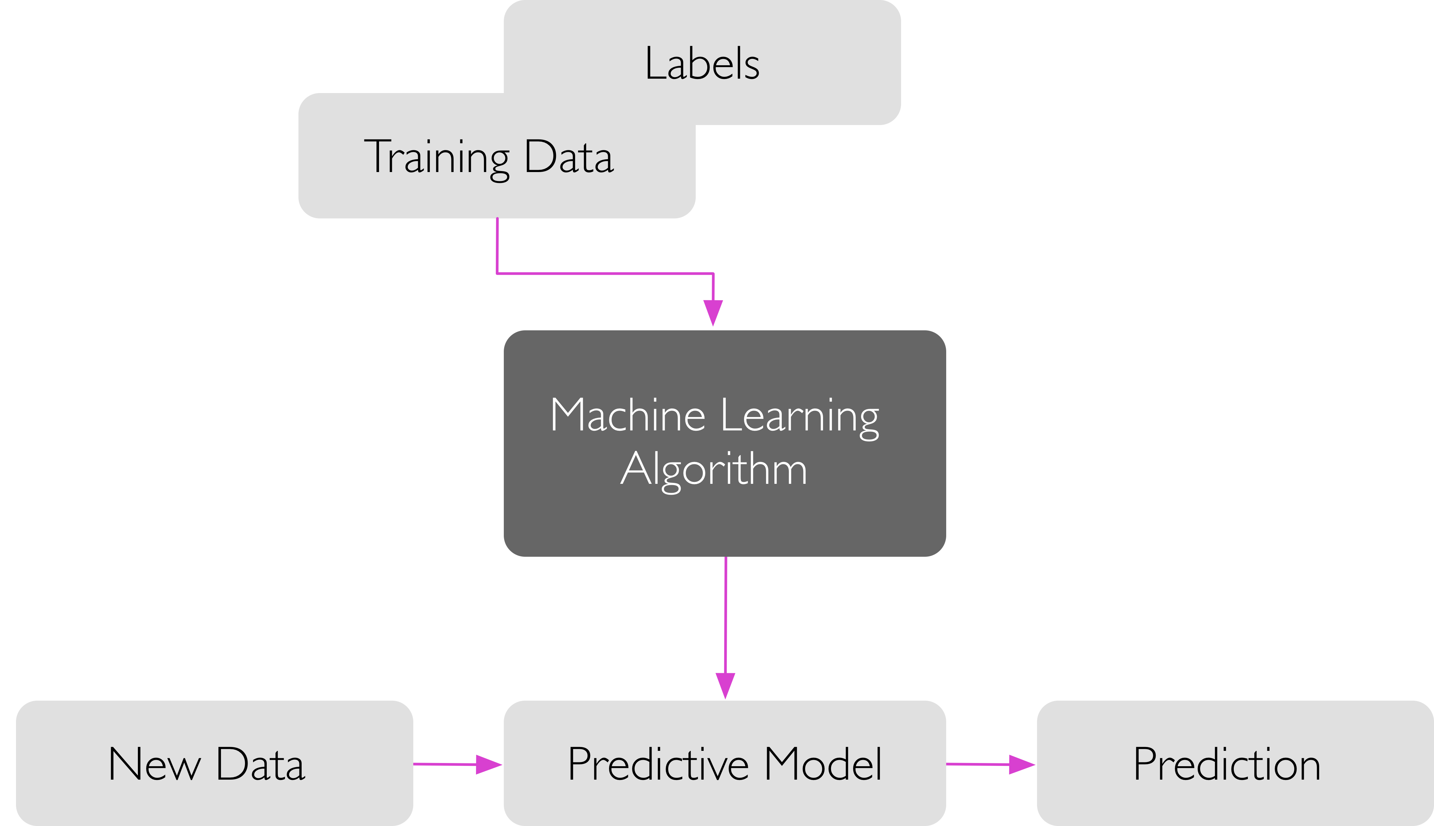
Classification
Image from
https://github.com/rasbt/python-machine-learning-book-2nd-edition
S. Raschka and V. Mirjalili, Python Machine Learning (2nd Ed.)

Slide 8
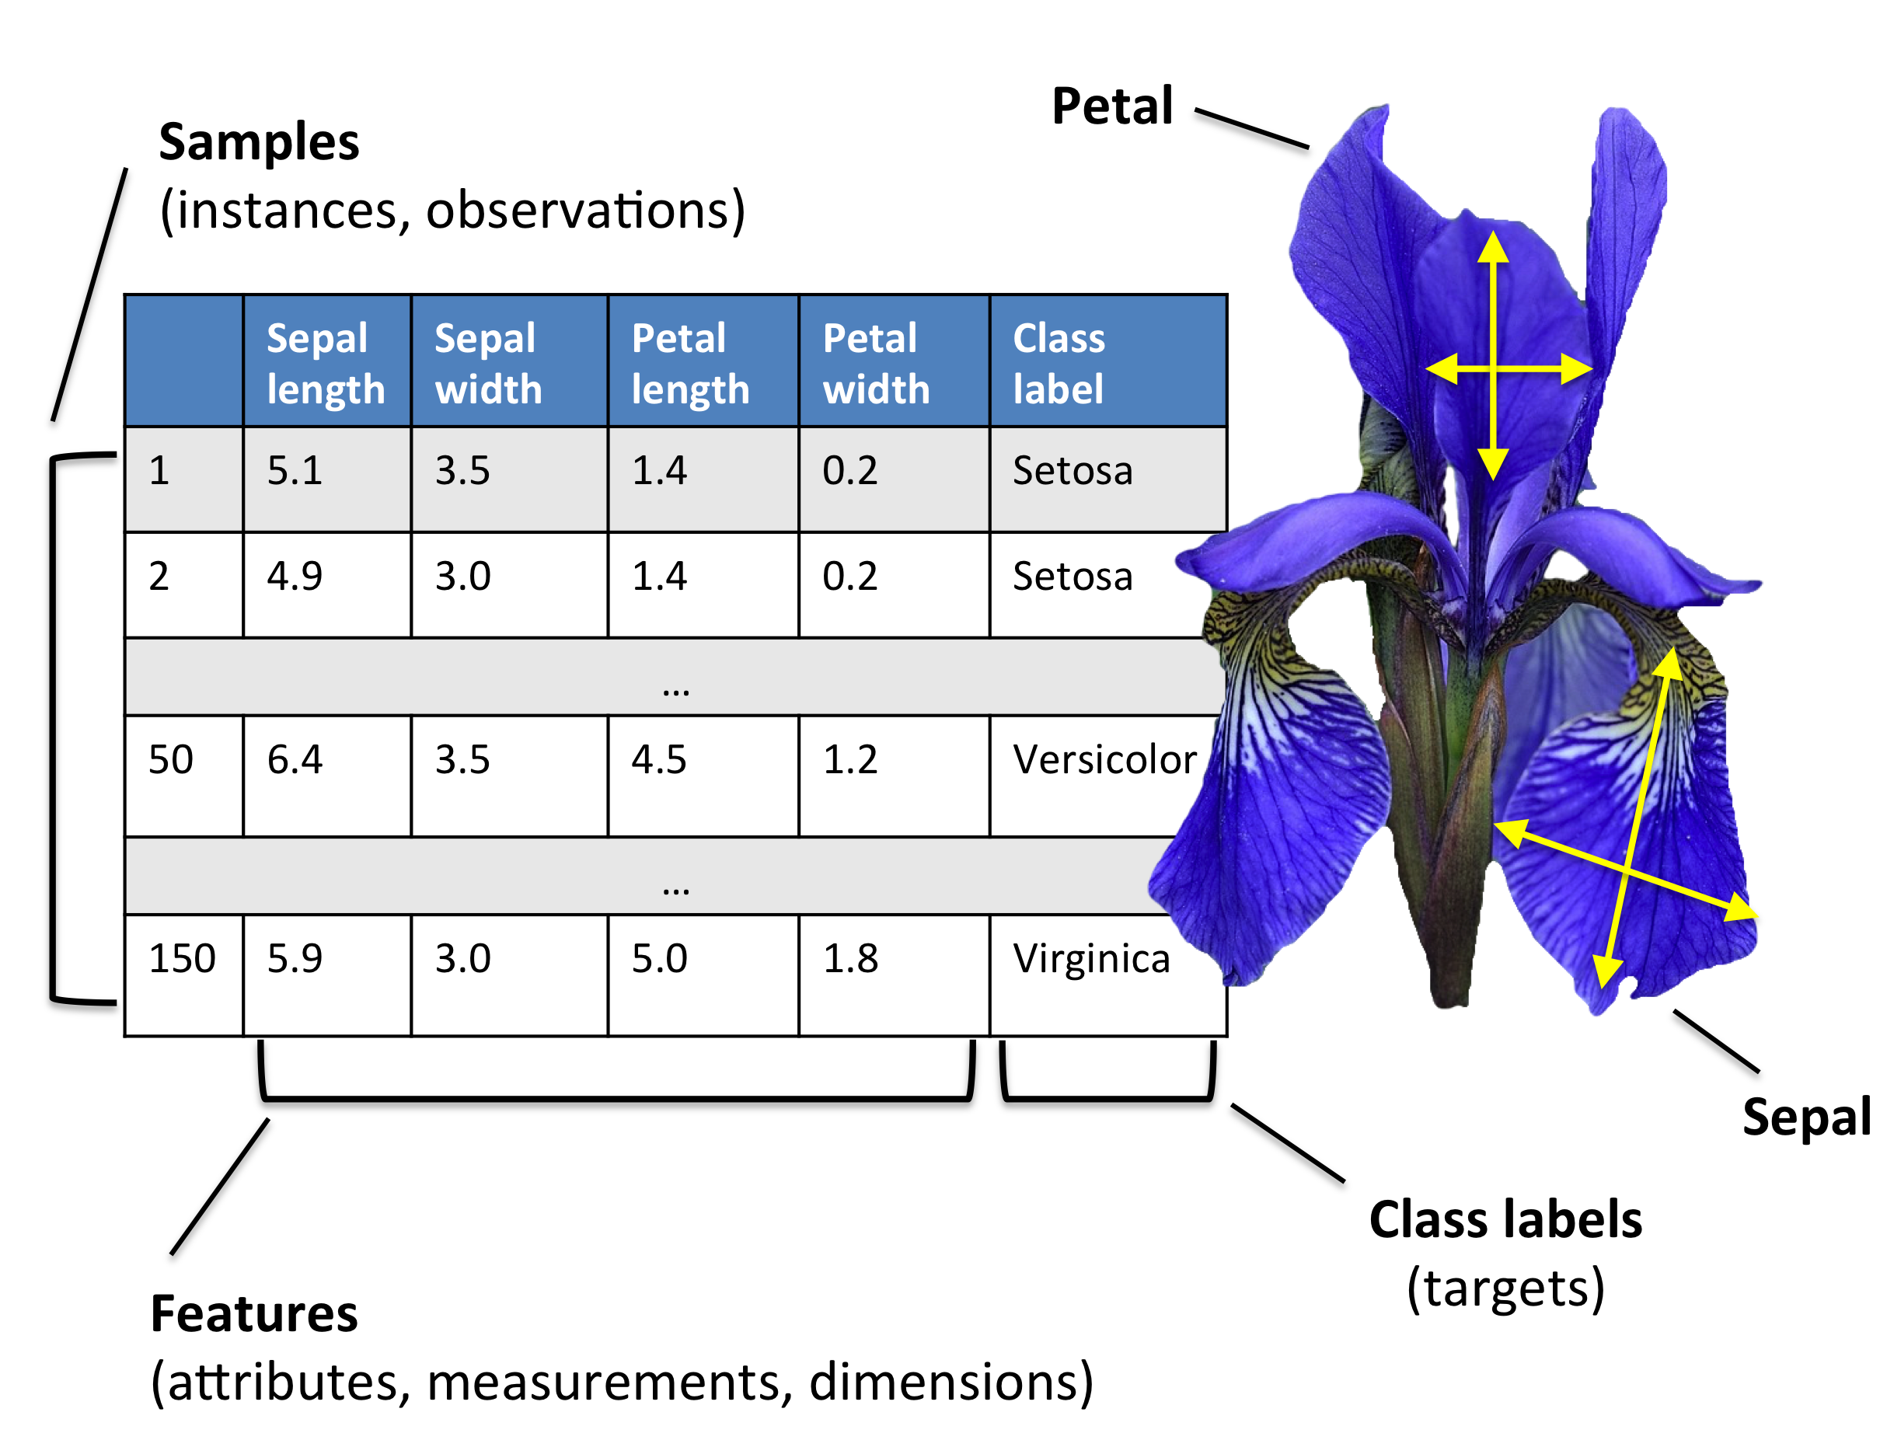
Data Format
Image from
https://github.com/rasbt/python-machine-learning-book-2nd-edition
S. Raschka and V. Mirjalili, Python Machine Learning (2nd Ed.)

Slide 9
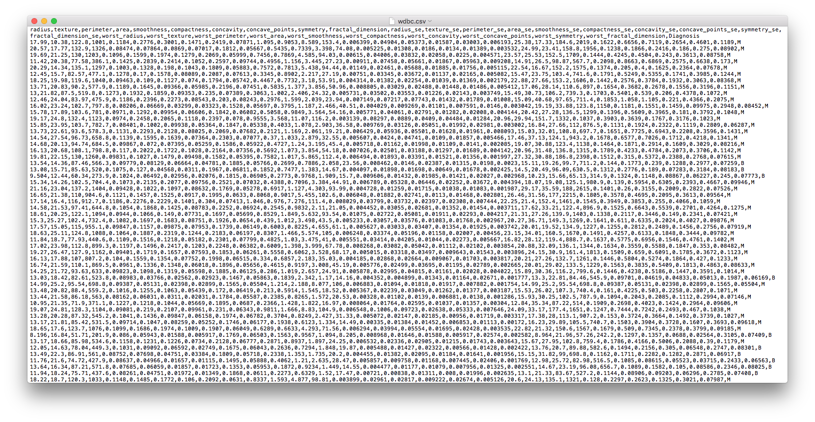
Data Format
A typical .csv file:

Slide 10
Load dataset in ML4Bio software

Slide 11
ML workflow
Image from
https://github.com/rasbt/python-machine-learning-book-2nd-edition
S. Raschka and V. Mirjalili, Python Machine Learning (2nd Ed.)

Slide 12
Workflow example in Jupyter notebook

Slide 13
Step 1: Preprocessing
Before training a classifier, raw data needs to be
Transformed (images, sequences, text, spectra)
Cleaned (missing values, typos, inconsistency)
Combined (date from different sources/modalities)
Normalized (batch effect, features in different scales)
Encoded (categorical features)
Feature engineering is the key.

Slide 14
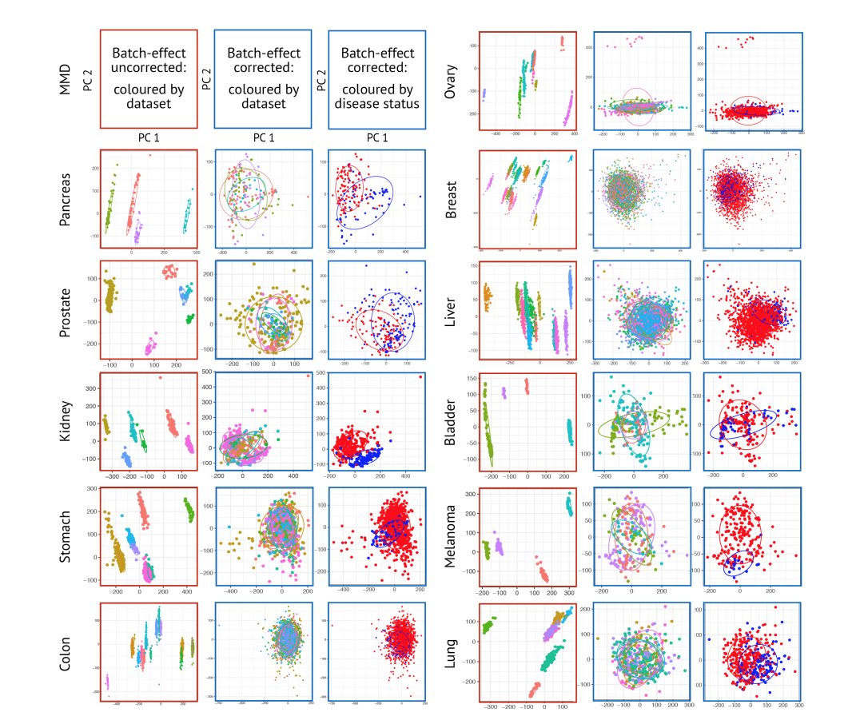
Data normalization
Su Bin Lim, Swee Jin Tan, Wan-Teck Lim, Chwee Teck Lim.
Compendiums of Cancer Transcriptome for Machine Learning Applications
BioRxiv 353698 [Preprint]. June 22, 2018 Available from: https://doi.org/10.1101/353698

Slide 15
Data encoding
shape | size | extravasation | class
bean | small | yes | cancer
oval | large | yes | normal
bean | small | no | cancer
round | medium | no | normal
oval | medium | no | cancer
bean | oval | round
1 | 0 | 0
0 | 1 | 0
1 | 0 | 0
0 | 0 | 1
0 | 1 | 0
size
0
2
0
1
1
extravasation
1
1
0
0
0
class
1
0
1
0
1
One-hot encoding
Integer encoding

Slide 16
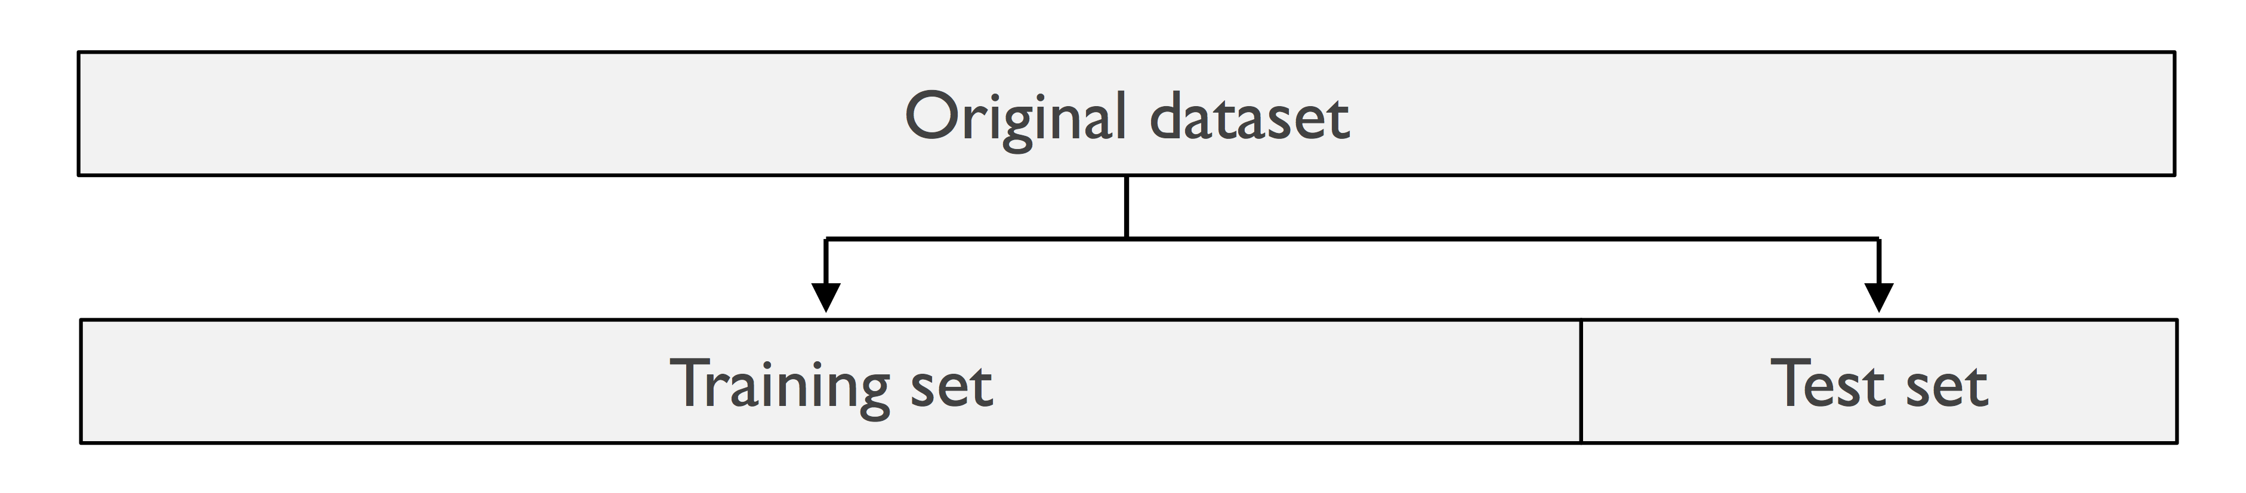
Train/test split
Image adapted from
https://github.com/rasbt/python-machine-learning-book-2nd-edition
S. Raschka and V. Mirjalili, Python Machine Learning (2nd Ed.)

Slide 17
Split data in ML4Bio software

Slide 18
Step 2: Learning
Training
Choose classifier type
Set hyperparameters (if applicable)
Apply a learning algorithm
Validation
Estimate classifier performance
Hyperparameter optimization
Classifier selection

Slide 19

Training
Classifier types
Logistic Regression
Neural Networks
Decision Trees
Random Forests
Support Vector Machine (SVM)
K-Nearest Neighbors (if time permits)
Naïve Bayes (if time permits)
Learning algorithms
Optimization of an objective function
A lot of math behind
Image from
https://blog.paperspace.com/intro-to-optimization-in-deep-learning-gradient-descent
A. Kathuria, Intro to optimization in deep learning: Gradient Descent

Slide 20
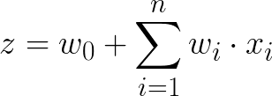
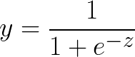
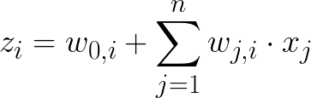
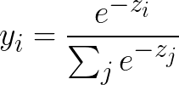
Logistic Regression: Representations and Inference
1
w₀
Binary setting
x₁
w₁
w₂
z
logistic
y
0.86
x₂
w_{n}
…
x_{n}
1
Multi-class setting
(e.g. 3 classes)
z₁
y₁
0.76
x₁
z₂
softmax
y₂
0.05
x₂
…
z₃
y₃
0.19
x_{n}

Slide 21
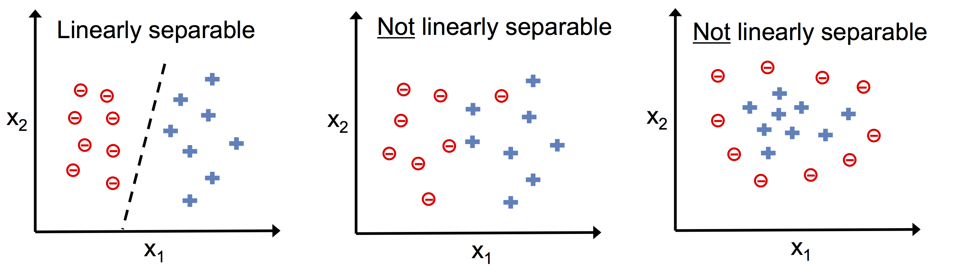
Linearly Separable vs. Not Linearly Separable
Image from
https://github.com/rasbt/python-machine-learning-book-2nd-edition
S. Raschka and V. Mirjalili, Python Machine Learning (2nd Ed.)

Slide 22
Neural Network: Representations
1
1
x₁
a₁
c₁
z
logistic
y
0.73
Binary
x₂
activation function
(linear, relu, logistic, tanh)
a₂
c₂
…
x_{n}
a₃
c₃
Input layer
Hidden layer
Output layer
Prediction

Slide 23
Neural Network: Representations
1
1
z₁
y₁
0.09
x₁
a₁
c₁
z₂
y₂
0.05
softmax
Multiclass
(e.g. 4 classes)
x₂
activation function
(linear, relu, logistic, tanh)
a₂
c₂
z₃
y₃
0.62
…
x_{n}
a₃
c₃
z₄
y₄
0.24
Input layer
Hidden layer
Output layer
Prediction

Slide 24
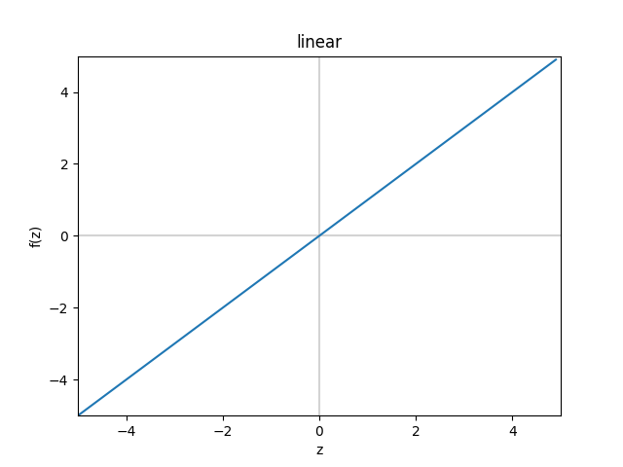
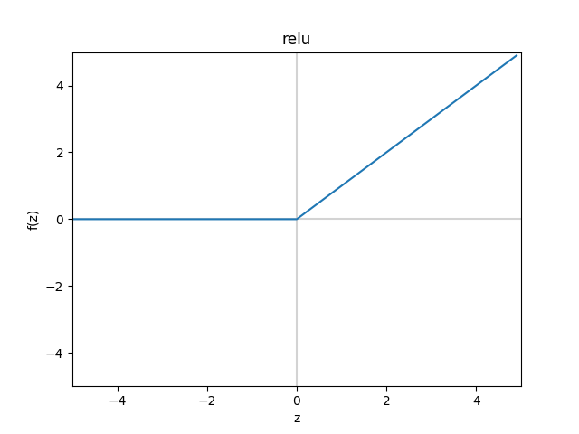
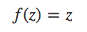
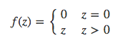
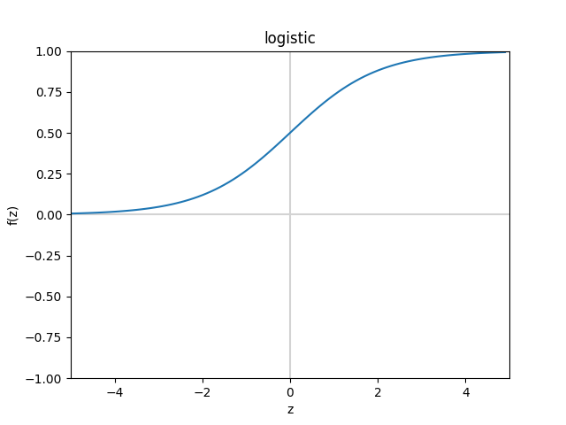
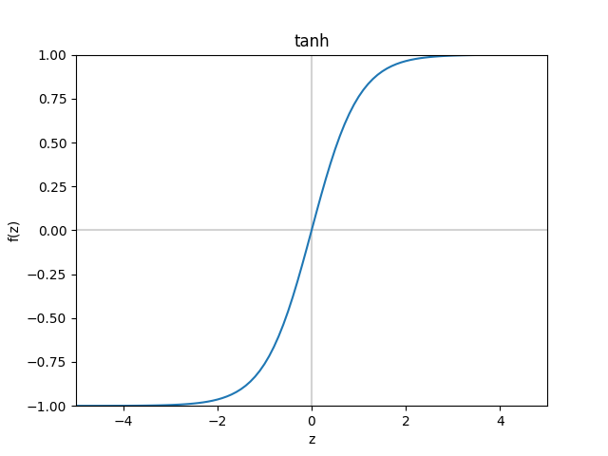
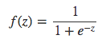
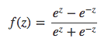
Logistic Regression & Neural Network: Activation Functions

Slide 25
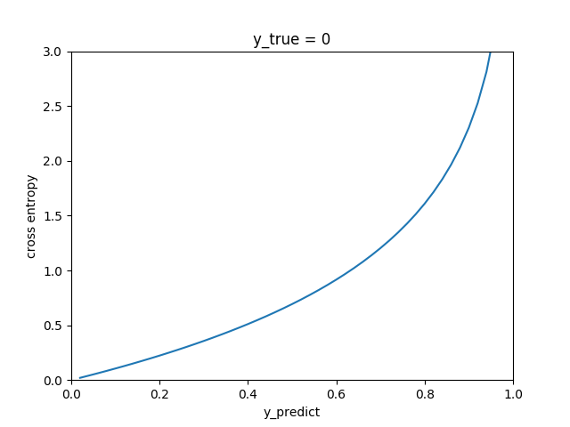
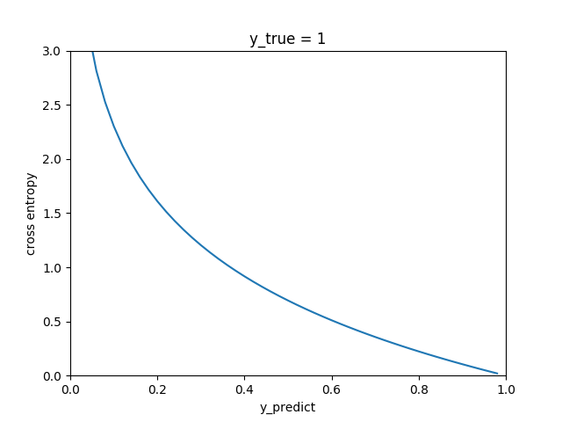
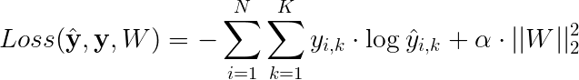
Logistic Regression & Neural Network: Learning
Binary problem:
Cross-entropy loss
L2 regularization
Multiclass problem:

Slide 26
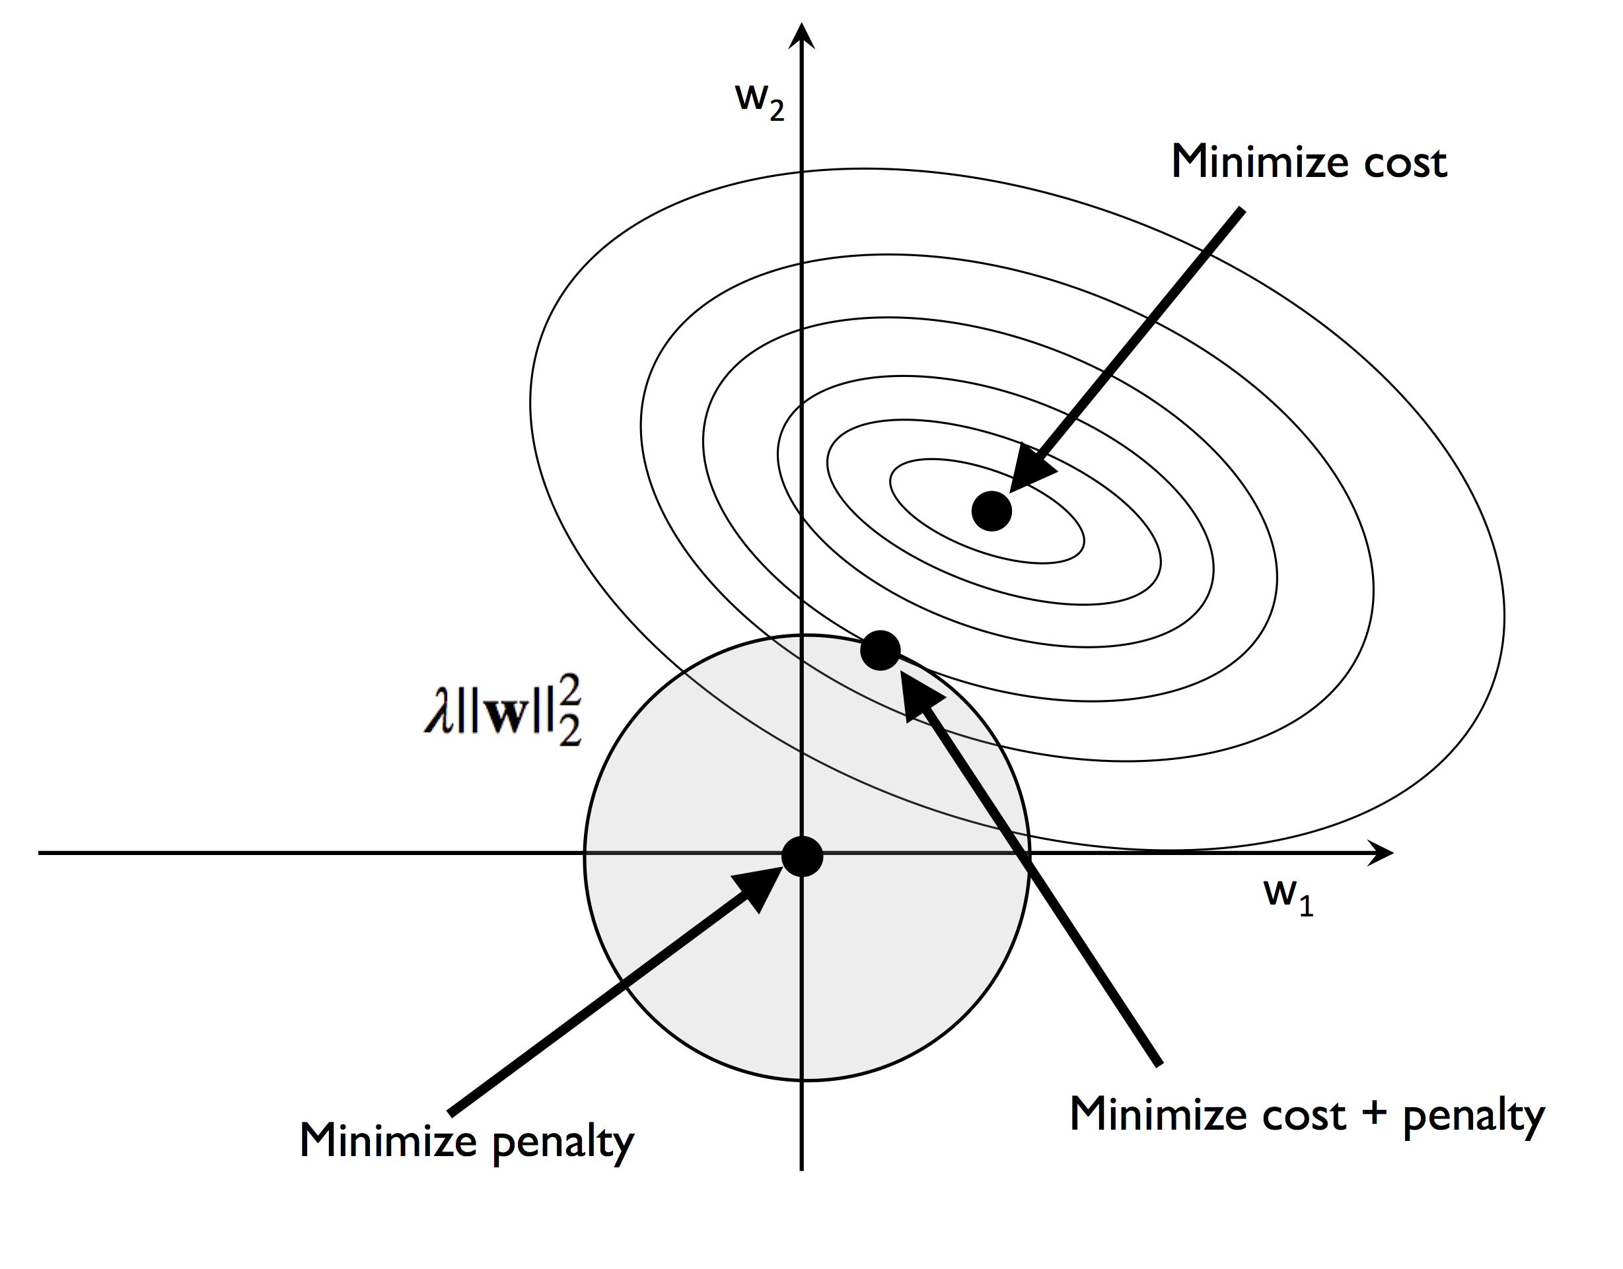
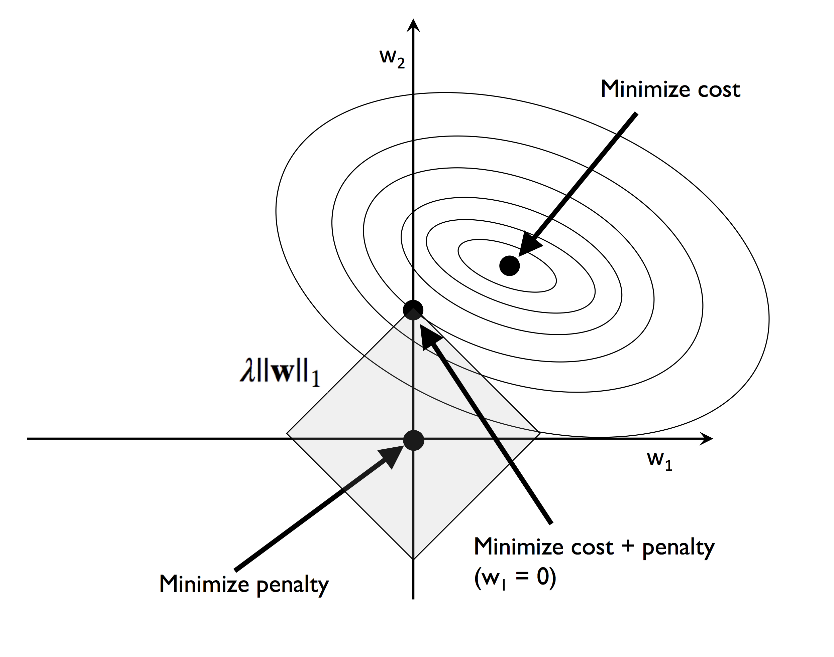
Regularization
L2 regularization:
L1 regularization:
Images from
https://github.com/rasbt/python-machine-learning-book-2nd-edition
S. Raschka and V. Mirjalili, Python Machine Learning (2nd Ed.)

Slide 27
Practice
Practice training logistic regression and neural network models in the ML4Bio software
Questions:
Why is logistic regression a linear classifier?
How does regularization strength affect learning?
Do different solvers produce the same decision boundary? Why? (Hint: local optima)
Is it always better to use more hidden units in a neural network?
What is the effect of learning rate in neural network learning?

Slide 28
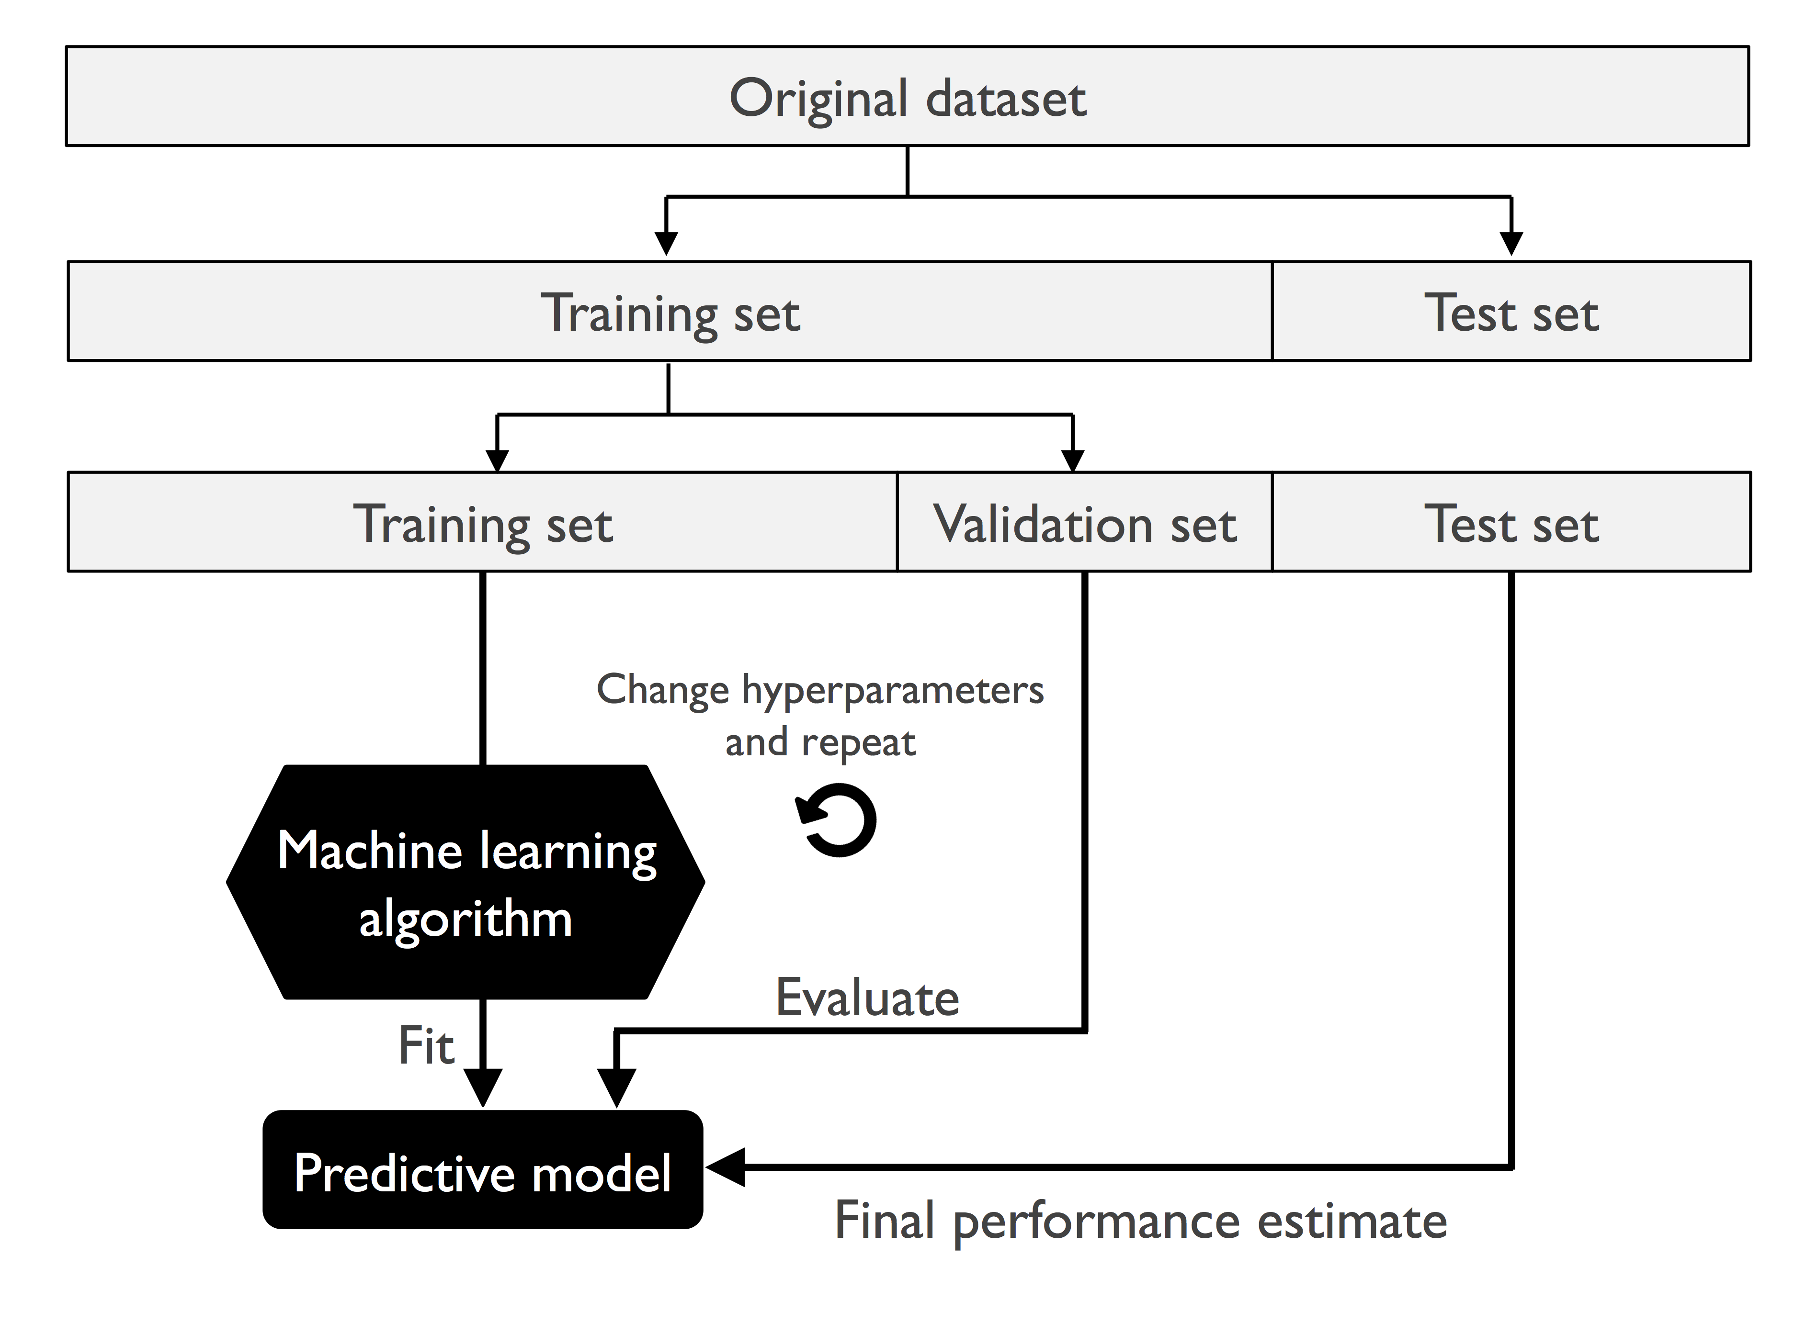
Validation
Hold-out validation
Image from
https://github.com/rasbt/python-machine-learning-book-2nd-edition
S. Raschka and V. Mirjalili, Python Machine Learning (2nd Ed.)

Slide 29
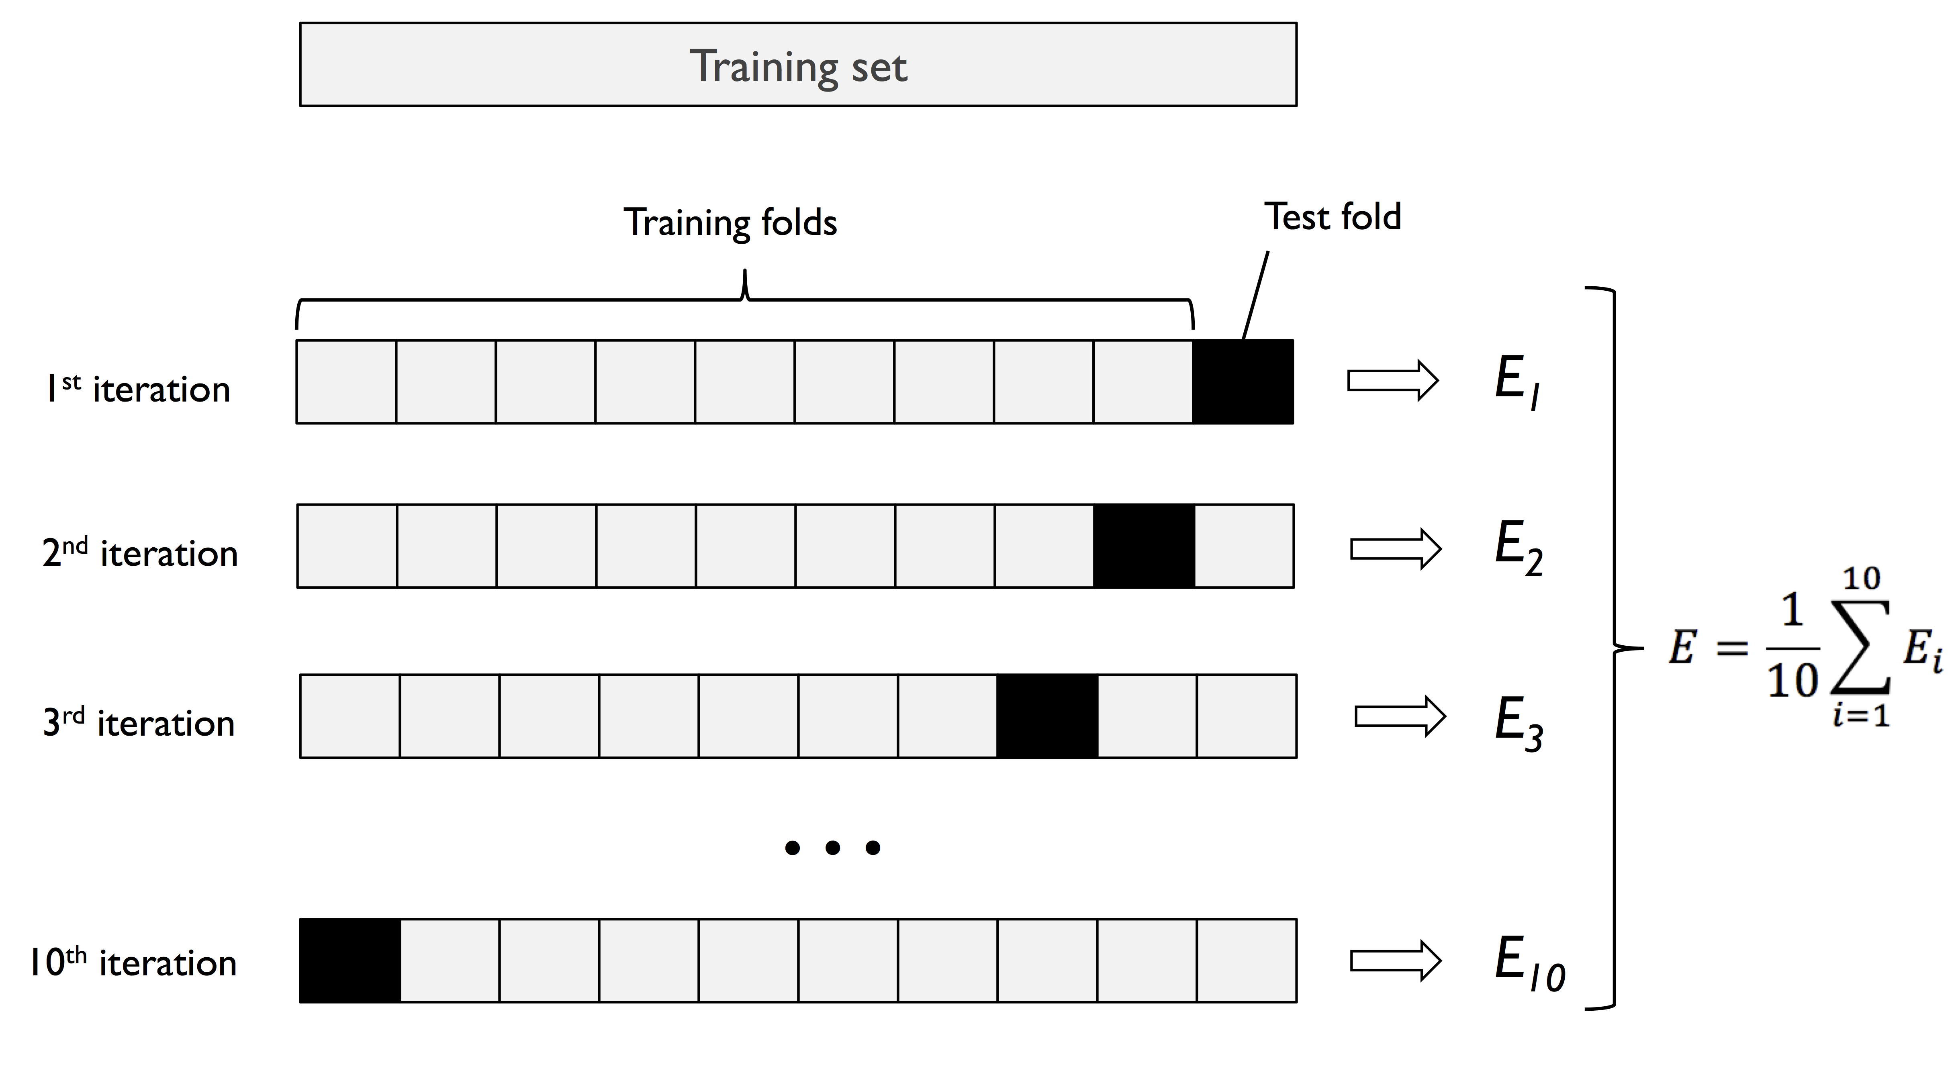
Validation
K-fold cross-validation
Image from
https://github.com/rasbt/python-machine-learning-book-2nd-edition
S. Raschka and V. Mirjalili, Python Machine Learning (2nd Ed.)

Slide 30
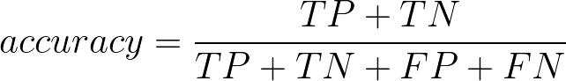
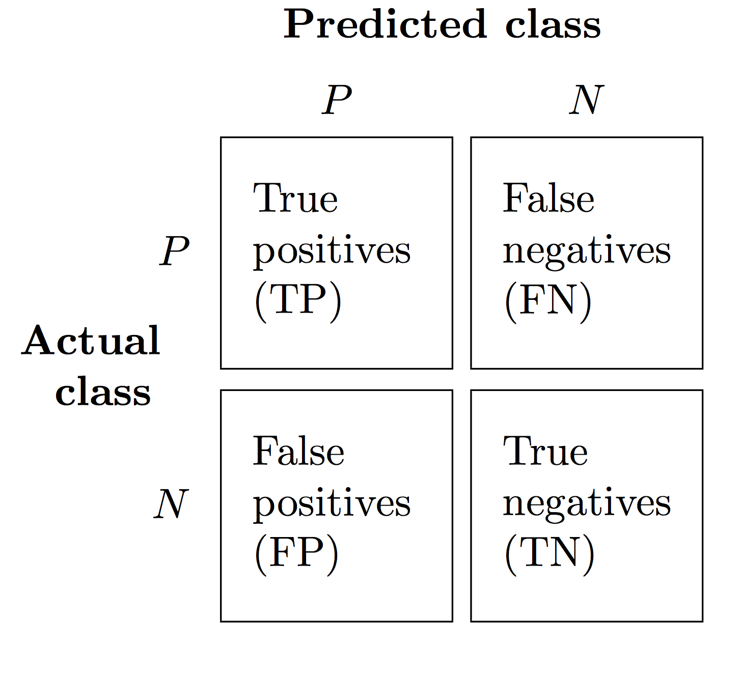
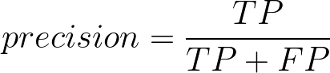
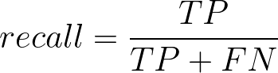
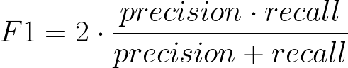
Performance Metrics
Image from
https://github.com/rasbt/python-machine-learning-book-2nd-edition
S. Raschka and V. Mirjalili, Python Machine Learning (2nd Ed.)

Slide 31
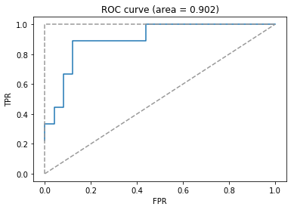
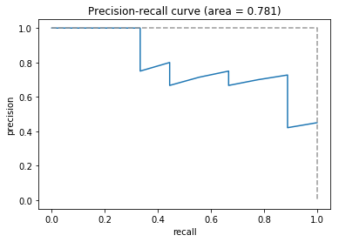
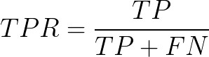
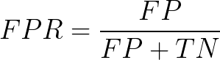
Plots
Receiver operating characteristic (ROC) curve
Precision-recall curve

Slide 32
Review performance measures for trained models in ML4Bio software

Slide 33
Decision Tree: Representation and Inference
Exercises
no
yes
Age
No
< 30
≥ 30
Internal node
No
BMI
< 25.5
≥ 25.5
Leaf node
No
Yes

Slide 34
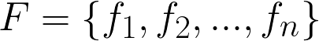
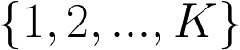
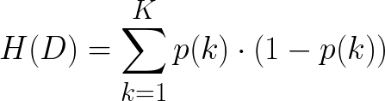
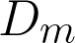








Decision Tree: Learning
Feature set
Classes
Measure of uncertainty:
Gini
Given training data of size at node ,
Entropy
For feature :
where
Split with feature that reduces uncertainty
the most:

Slide 35
Random Forest: Representation, Learning and Inference
Training data D
Sample D with replacement
(Bootstrap)
Set D₁
Set D₂
Set D_{T-1}
Set D_{T}
Feature Set F
T trees
Sample F without replacement at each node
Learning
……
Given a new sample x
+
+
……
-
+
Inference
Majority vote
+

Slide 36
Practice
Practice training decision tree and random forest models in the ML4Bio software
Questions:
What does the decision boundary produced by decision trees (DT) look like? Why? How about random forests (RF)?
Which algorithm performs better in general? DT or RF? Why?
If we let a DT to grow freely without any regularization, how would the data at each leaf node look like?
What other strategies can be applied to DT/RF learning to encourage generalization? (Hint: reduction in uncertainty)

Slide 37








Linear SVM: Representation, Learning and Inference
Objective function:
margin
Margin size
Slack penalty
subject to
slack
support vector
Given a new point ,

Slide 38










Kernel SVM: Representation
linear
RBF
polynomial
sigmoid

Slide 39
Practice
Practice training SVM models in the ML4Bio software
Questions:
Why can a kernel SVM learn nonlinear decision boundary?
How does margin size change in response to change in penalty strength of a linear SVM?
How does accuracy on training and validation data change as you vary the coefficient of RBF kernel?
Do you think kernel SVM is always better than linear SVM in practice? Why? (Hint: generalization)

Slide 40

Underfitting and Overfitting
Image from
https://github.com/rasbt/python-machine-learning-book-2nd-edition
S. Raschka and V. Mirjalili, Python Machine Learning (2nd Ed.)

Slide 41





K-Nearest Neighbors: Representation, Learning and Inference
Class 0 training point
Class 1 training point
New point
K = 3
K = 5
Find K training points
closest to the new point .
Measure of distance:
Manhattan distance
(L¹ distance)
Euclidean distance
(L² distance)

Slide 42
Practice
Practice training KNN models in the ML4Bio software
Questions:
As K increases, the decision boundary becomes smoother. Why?
Why is KNN not appropriate for data with a mixture of discrete and continuous data? (Hint: distance)
Does KNN work well in high-dimensional space? Why?

Slide 43





Naïve Bayes: Representation and Inference
y
Class
x₁
x₂
x₃
x₄
……
x_{n}
Features
(independence)
Discrete feature
Continuous feature

Slide 44




Naïve Bayes: Learning
Recall
To estimate :
To estimate :
Discrete feature
Continuous feature

Slide 45
Practice
Practice training Naïve Bayes models in the ML4Bio software
Questions:
For 2D continuous data with binary labels, the decision boundary produced by a NB classifier is a circle. Why? (Hint: distribution, independence)
How does class priors affect classification?
Can NB handle data with a mixture of discrete and continuous data? Why?
How would you encode categorical features in NB?

Slide 46
Step 3: Evaluation
Why do we only evaluate on the test set one time?

Slide 47
Step 4: Prediction
Trained models can make predictions on new unlabeled samples

Slide 48

Next Steps
Visit the accompanying guides
Scikit-learn tutorials
Python Machine Learning book code examples
Jake VanderPlas tutorial
Regression, unsupervised learning, feature engineering, and other topics we did not cover

Slide 49
Acknowledgements
ML consultants: Chris Magnano, Ross Kleiman, Zijie (Jay) Wang
Debora Treu
Megan McClean
Python Machine Learning book authors Sebastian Raschka and Vahid Mirjalili
NSF 1553206

